Slide 1
K-nearest neighbors 生醫光電所 吳育德
Chap5. A First Course in Machine Learning, 2ed, Simon Rogers and Mark Girolami, 2017

Slide 2
Outlines
You will learn non-probabilistic Classifiers
K-nearest neighbors
Linear regression
Perceptron and neural network
Support vector machines and other kernel methods
Decision tree
Random Forest
AdaBoost
You will learn probabilistic classifiers
Bayes classifier and Naïve Bayes classifier
Logistic regression

Slide 3
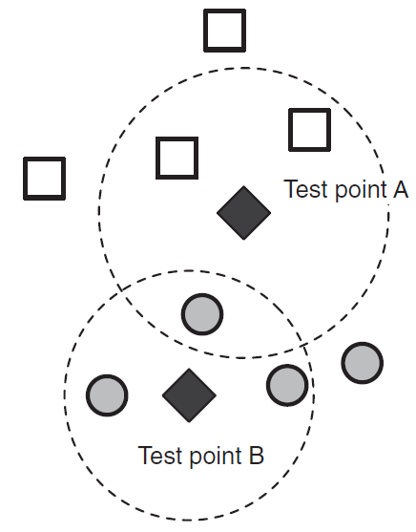
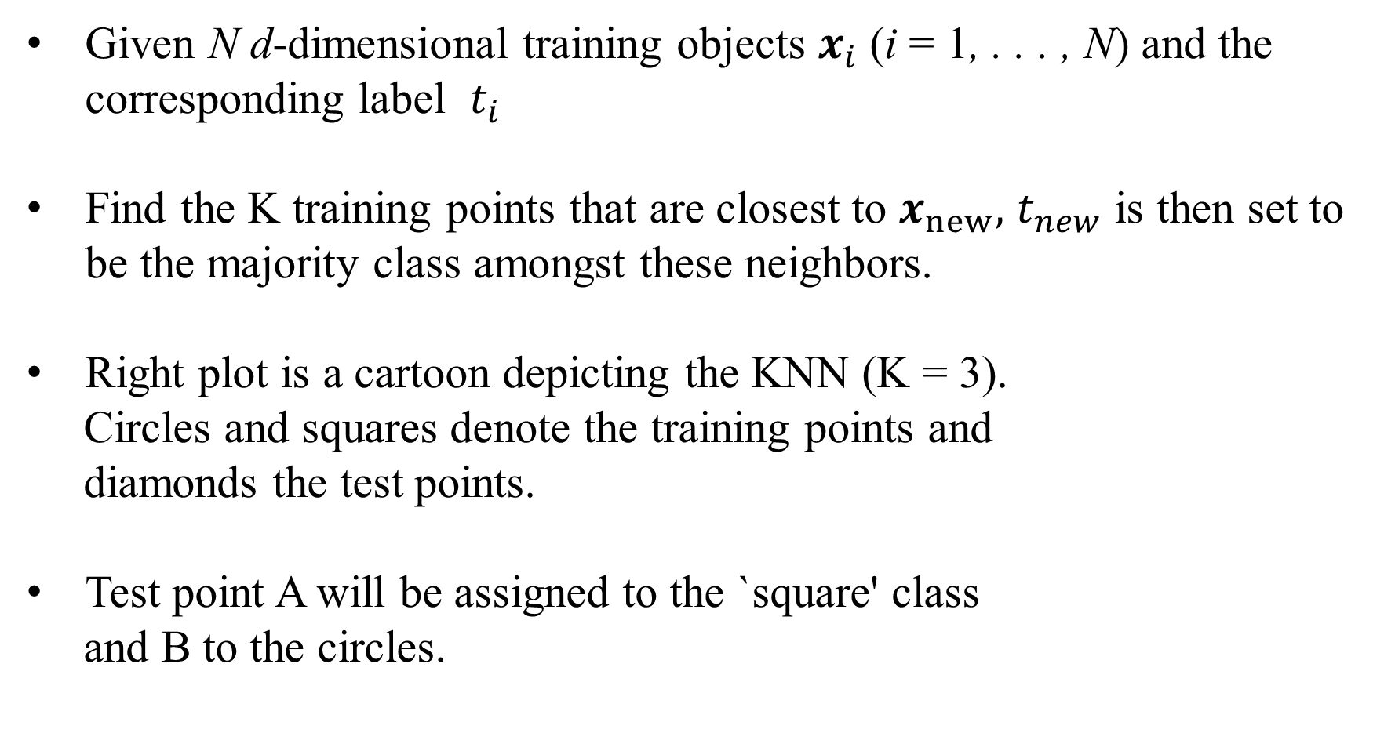
K-nearest neighbours
Given N d-dimensional training objects $x_{i}$ (i = 1, . . . , N) and the corresponding label $t_{i}$
Find the K training points that are closest to $x_{new},$ $t_{new}$ is then set to be the majority class amongst these neighbors.
Right plot is a cartoon depicting the KNN (K = 3).
Circles and squares denote the training points and
diamonds the test points.
Test point A will be assigned to the `square' class
and B to the circles.

Slide 4
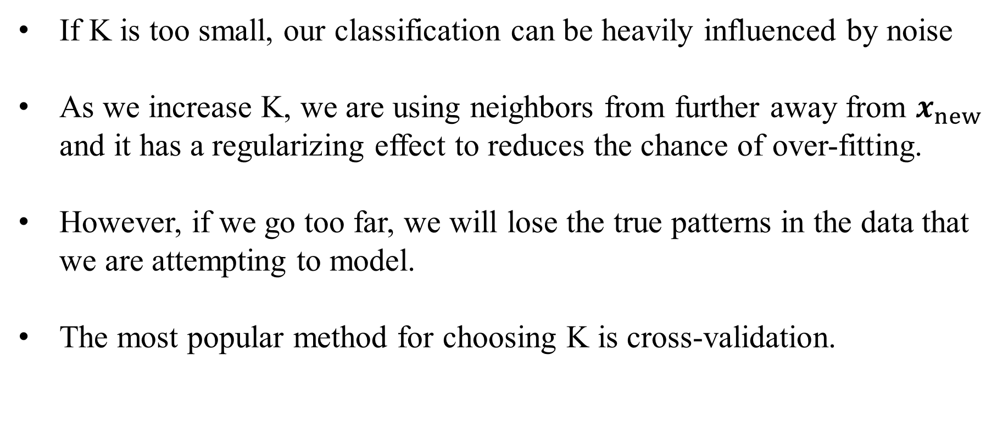
Choosing K
If K is too small, our classification can be heavily influenced by noise
As we increase K, we are using neighbors from further away from $x_{new}$ and it has a regularizing effect to reduces the chance of over-fitting.
However, if we go too far, we will lose the true patterns in the data that we are attempting to model.
The most popular method for choosing K is cross-validation.

Slide 5
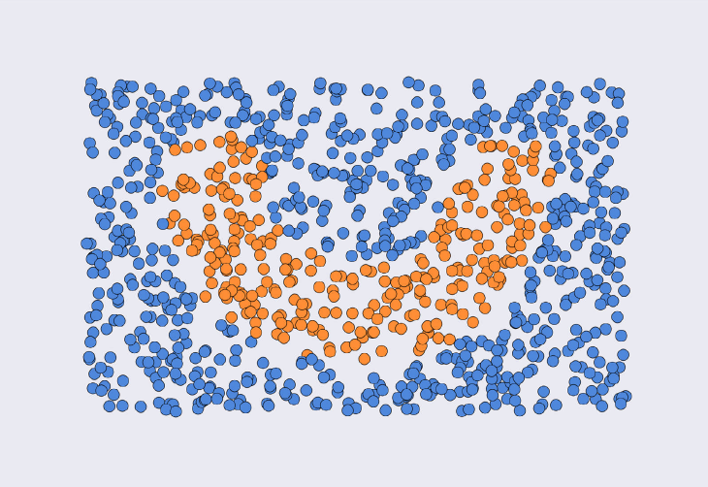
A “smile” dataset of 2D points
There are two categories, blue and orange
Deep Learning, Vol. 1_ From Basics to Practice Andrew Glassner, 2018

Slide 6
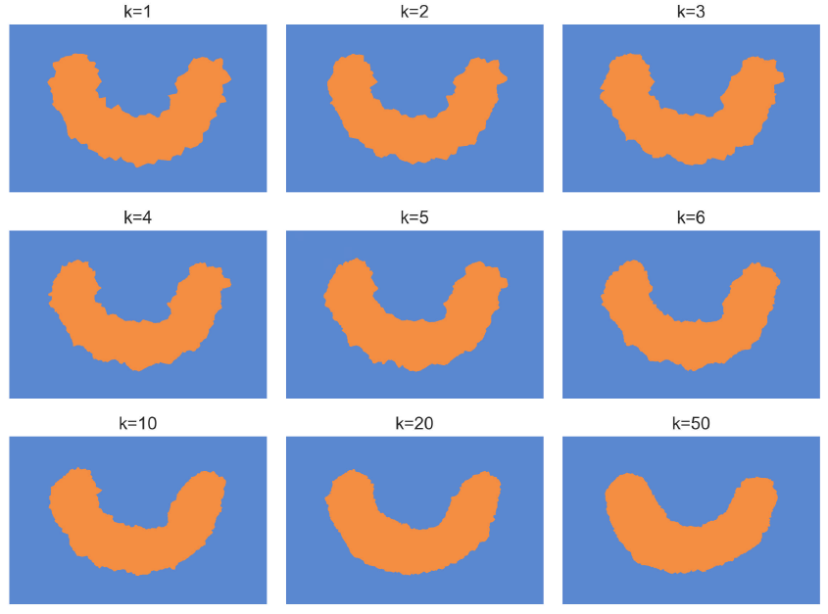
Classifying all the points in the rectangle for different k
Notes:
Notice how rough the edges are for low values of k, and how they smooth out as k increases. The k values in the top two rows go up by 1 with each image. The bottom row uses much bigger increments.

Slide 7
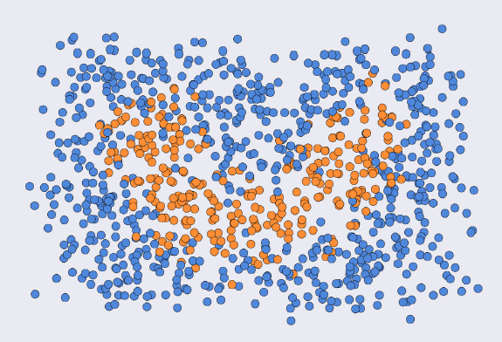
A noisy version of the smile dataset

Slide 8
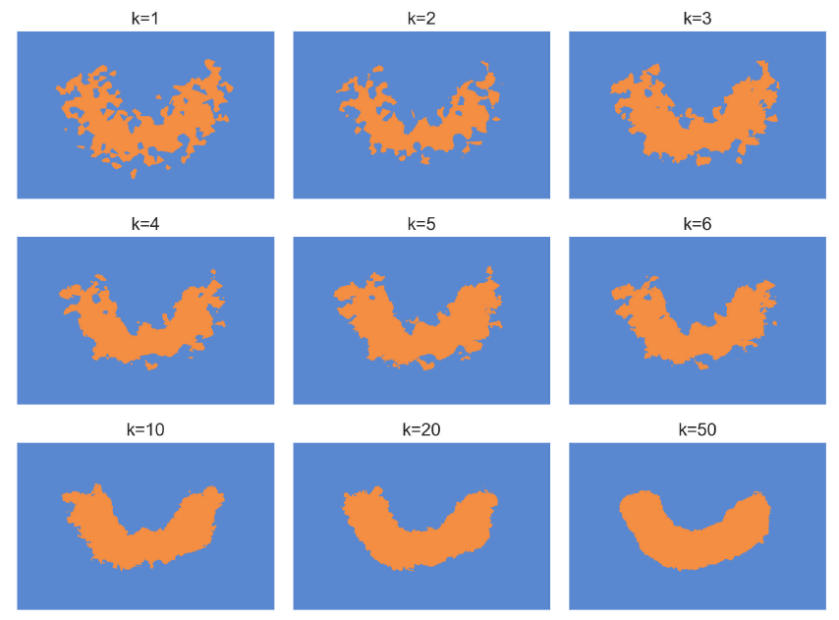
Using kNN to assign a category to points in the plane
Notes:
Note how much the algorithm overfits for low values of k. As the number of neighbors increases, the edges smooth out considerably.

Slide 9
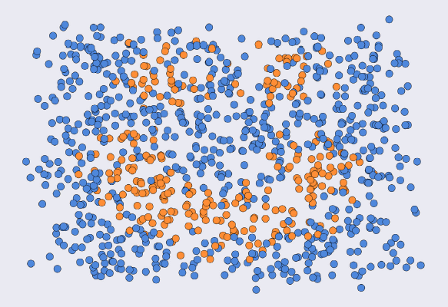
Adding two eyes to our smile database, then adding noise to
jitter the sample locations

Slide 10
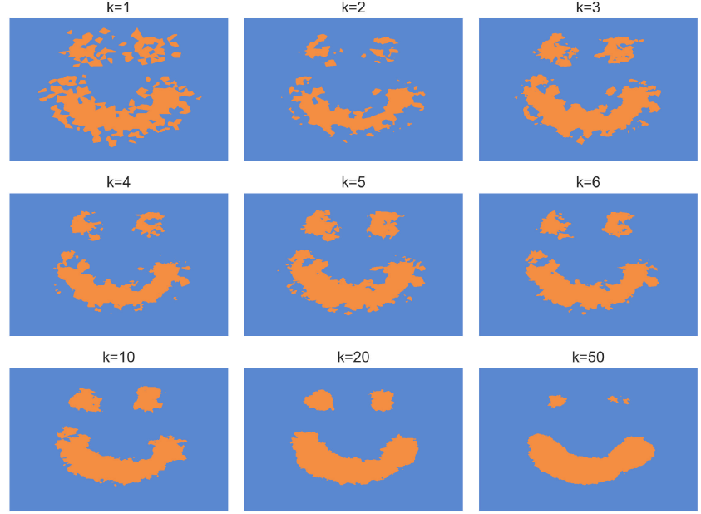
kNN doesn’t create boundaries between clusters of samples, so it works even when a class is broken up into pieces.
Notes:
As expected, the algorithm overfits at low values of k. But notice that when k=50, the eyes are disappearing. That’s because in the neighborhood of the eyes,
when we test for a large number of neighbors, the blue points will almost always dominate over orange. If we increased k further the eyes would disappear completely.

Slide 11
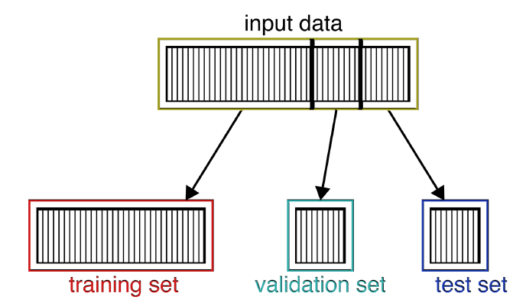
Splitting input data into a training, validation, and test set
Deep Learning, Vol. 1_ From Basics to Practice Andrew Glassner, 2018

Slide 12
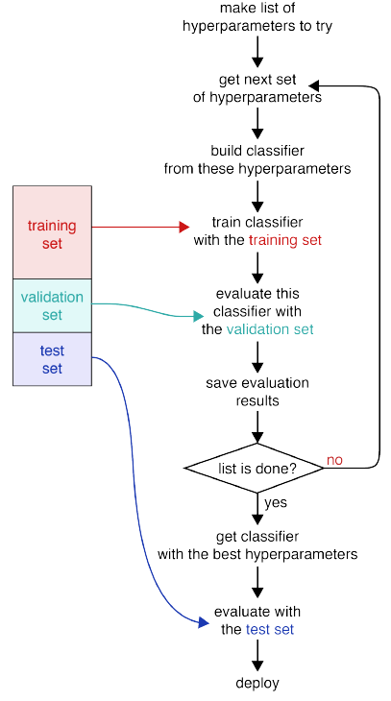
Use the validation set to decide the best hyperparameters
Deep Learning, Vol. 1_ From Basics to Practice Andrew Glassner, 2018

Slide 13
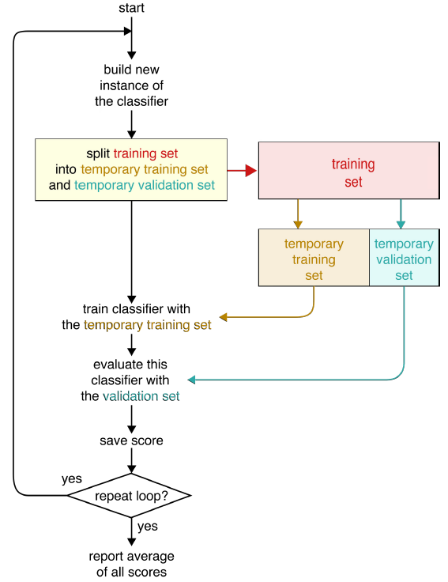
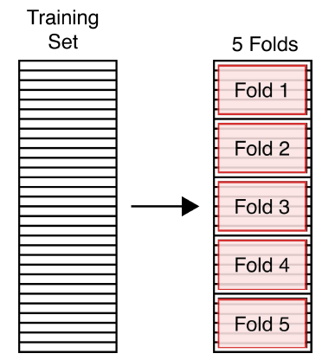
Using cross-validation to evaluate our system’s performance
Splitting our training set into 5 equally-sized folds, named Fold 1 through Fold 5.
Deep Learning, Vol. 1_ From Basics to Practice Andrew Glassner, 2018

Slide 14
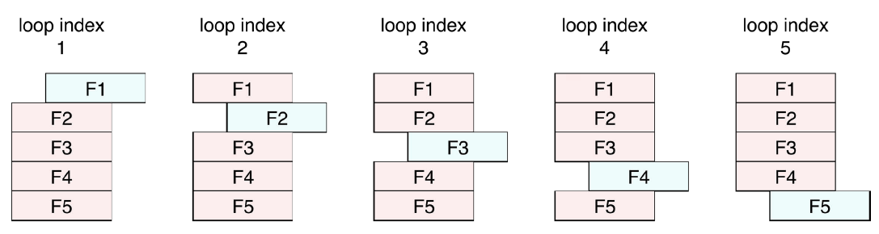
k-fold cross-validation
In each pass through the loop, we choose one fold for validation (in blue), and train with the others (in red).
Deep Learning, Vol. 1_ From Basics to Practice Andrew Glassner, 2018

Slide 15
MATLAB script: knncv.m
%% knncv.m % From A First Course in Machine Learning, Chapter 5.
% Cross-validation over K in KNN
clear all;close all;
%% Generate some data
N1 = 100; N2 = 20; % Class sizes
x = [randn(N1,2);randn(N2,2)+2];
t = [repmat(0,N1,1);repmat(1,N2,1)];
N = size(x,1);
%% Plot the data
ma = {'ko','ks'};
fc = {[0 0 0],[1 1 1]};
tv = unique(t);
figure(1);
for i = 1:length(tv)
pos = find(t==tv(i));
plot(x(pos,1),x(pos,2),ma{i},'markerfacecolor',fc{i});
hold on
end
%% loop over values of K
Nfold = 10; Kvals = [1:2:30]; Nrep = 100;
Errors = zeros(length(Kvals),Nfold,Nrep);

Slide 16
for rep = 1:Nrep
%% Permute the data and split into folds
order = randperm(N);
Nfold = 10; % 10-fold CV
sizes = repmat(floor(N/Nfold),1,Nfold);
sizes(end) = sizes(end) + N - sum(sizes);
csizes = [0 cumsum(sizes)];
for kv = 1:length(Kvals)
K = Kvals(kv);
for fold = 1:Nfold % Loop over folds
trainX = x;
traint = t;
foldindex = order(csizes(fold)+1:csizes(fold+1));
trainX(foldindex,:) = [];
traint(foldindex) = [];
testX = x(foldindex,:);
testt = t(foldindex);

Slide 17
% Do the KNN
classes = zeros(size(testX,1),1);
for i = 1:size(testX,1)
this = testX(i,:);
dists = sum((trainX - repmat(this,size(trainX,1),1)).^2,2);
[d I] = sort(dists,'ascend');
[a,b] = hist(traint(I(1:K)),unique(t));
pos = find(a==max(a));
if length(pos)>1
temp_order = randperm(length(pos));
pos = pos(temp_order(1));
end
classes(i) = b(pos);
end
Errors(kv,fold,rep) = sum(classes~=testt);
end
end
end
%% Plot the results
figure(2);
s = sum(sum(Errors,3),2)./(N*Nrep);
plot(Kvals,s);xlabel('K');ylabel('Error');

Slide 18
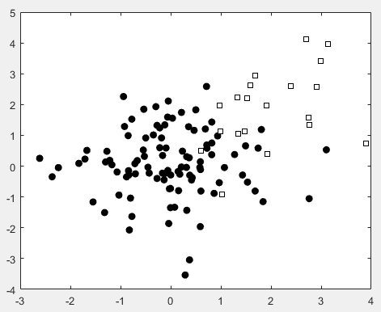
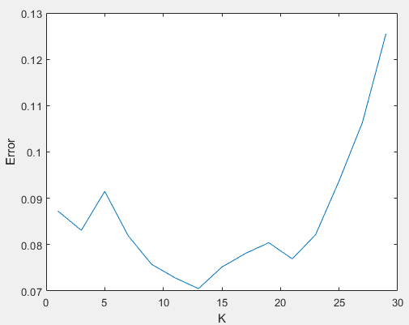
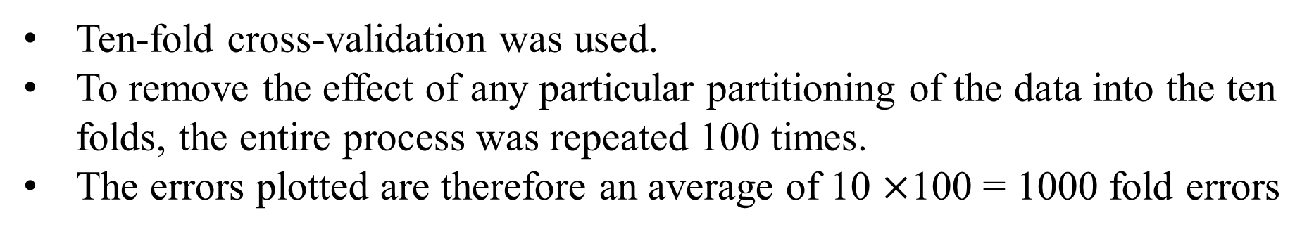
Results of MATLAB script: knncv.m
Ten-fold cross-validation was used.
To remove the effect of any particular partitioning of the data into the ten folds, the entire process was repeated 100 times.
The errors plotted are therefore an average of 10 $×$100 = 1000 fold errors

Slide 19
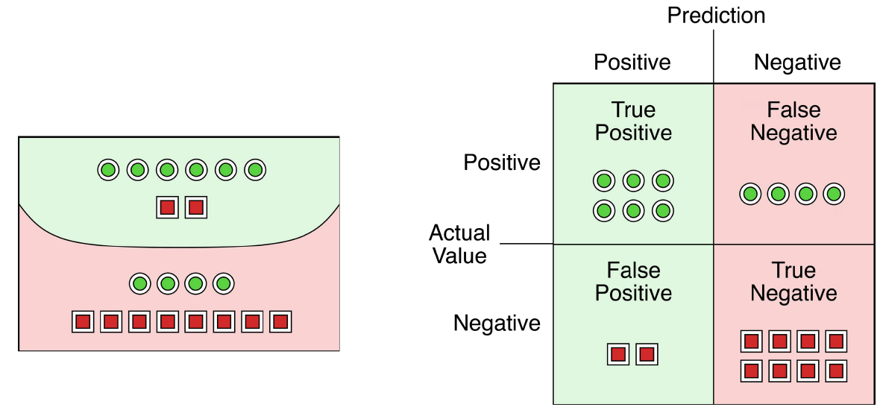
Confusion matrix
以看門狗辨識小偷為例：
小偷
一般人
Andrew Glassner - Deep Learning_ A Visual Approach-No Starch Press (2021)

Slide 20
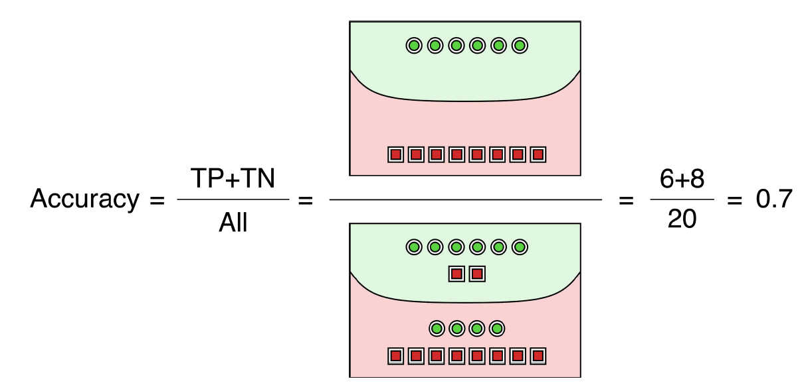
Accuracy
所有人當中辨識出小偷的比例
Andrew Glassner - Deep Learning_ A Visual Approach-No Starch Press (2021)

Slide 21
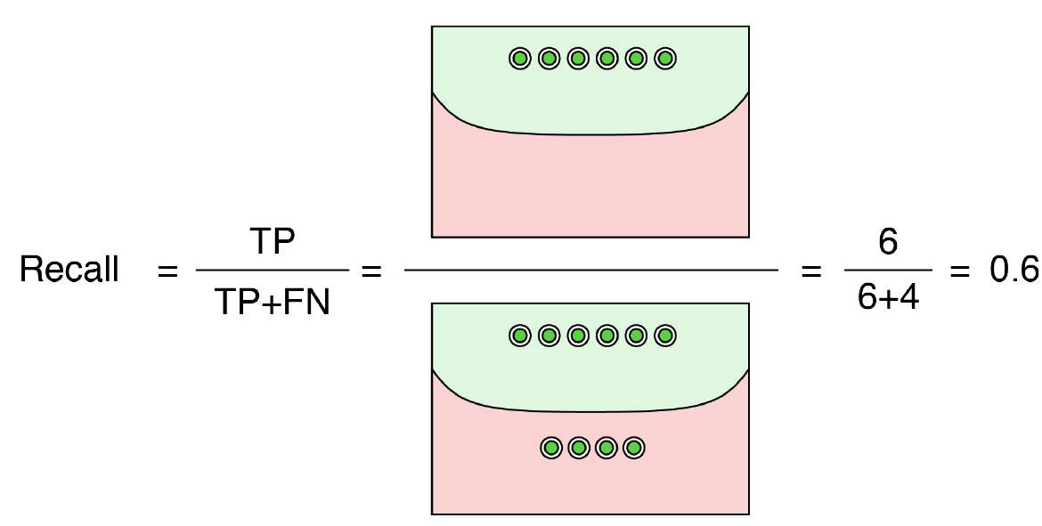
Recall (also called sensitivity)
所有小偷當中被辨識出小偷的比例
Andrew Glassner - Deep Learning_ A Visual Approach-No Starch Press (2021)

Slide 22
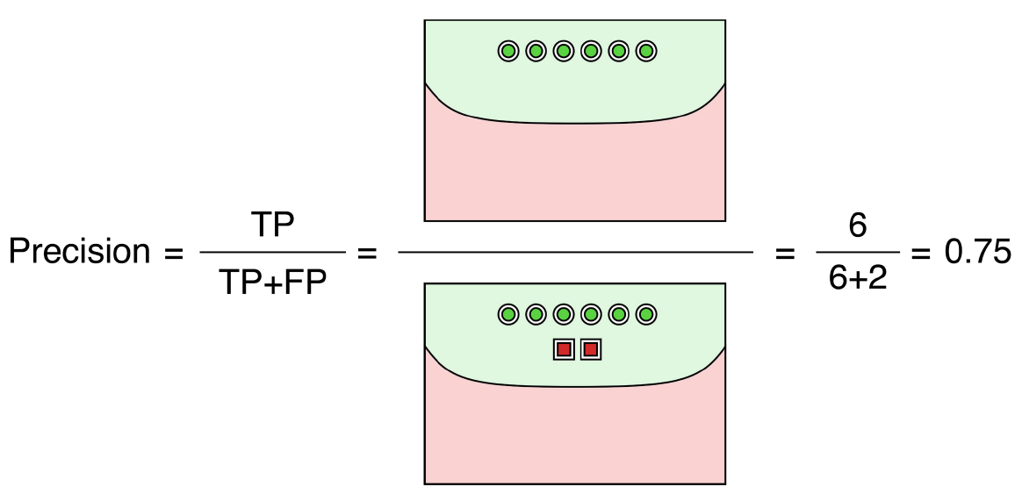
Precision (also called positive predictive value, or PPV)
被辨識為小偷當中真正是小偷的比例

Slide 23
Precision-Recall Tradeoff
以兩隻看門狗辨識小偷為例：
其中一隻是沒有經驗的小狗，只要有人靠近牠就會狂吠，但是這些人當中，只有少部分是真正小偷。
recall高，因為不管是不是小偷，牠都狂吠，不會錯過小偷
precision低，因為大多數都不是小偷
「寧可錯抓一百，也不可放過一個」→ recall 高，但 precision 低
另一隻是老狗，非常沉著，大多數時間在睡覺，但是在少數清醒的時間，牠都可以辨識出小偷，好人牠都不會叫。
precision高，因為牠狂吠的一定是壞人
recall低，因為牠大多數時間睡覺時錯過了很多小偷
「寧可錯放一百，也不可冤枉一個」→ precision 高，但 recall 低

Slide 24
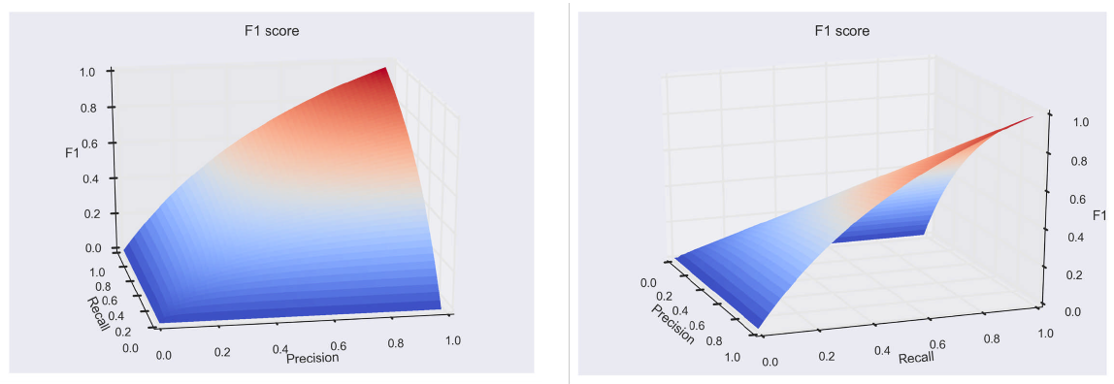

F1 Score (harmonic mean)
The F1 score is 0 when either precision or recall is also 0, and 1 when both are 1.
In between it slowly rises as both measures increase
F1=

Slide 25
Homework # 6
Implement the 10-fold cross validation
1.one time
2.100 times
to determine the optimal parameter K in the KNN algorithm.
Hint: see Homework 6_cross_validation_to_do.jpynb
Deadline of Homework #6: 2022/11/14 3:30pm

